Slide 1
http://www.vidyanidhi.com/
ketkiacharya.net@gmail.com
REACT JS
Ketki Acharya
From: SM VITA ATC of CDAC
9769201036
ketkiacharya.net@gmail.com

Slide 2
What is React js
ReactJS is JavaScript library used for building reusable UI components. According to React official documentation, following is the definition −
React is a library for building composable user interfaces.
It encourages the creation of reusable UI components, which present data that changes over time.
Lots of people use React as the V in MVC.
React abstracts away the DOM from you, offering a simpler programming model and better performance.
React can also render on the server using Node, and it can power native apps using React Native.
React implements one-way reactive data flow, which reduces the boilerplate and is easier to reason about than traditional data binding.

Slide 3
React Features
JSX − JSX is JavaScript syntax extension. It isn't necessary to use JSX in React development, but it is recommended.
Components − React is all about components. You need to think of everything as a component. This will help you maintain the code when working on larger scale projects.
Unidirectional data flow and Flux − React implements one-way data flow which makes it easy to reason about your app. Flux is a pattern that helps keeping your data unidirectional.
License − React is licensed under the Facebook Inc. Documentation is licensed under CC BY 4.0.

Slide 4
React.JS History
Latest version V 19
Current version of React.JS is V18.2.0 (June 14 2022).
Initial Release to the Public (V0.3.0) was in July 2013.
React.JS was first used in 2011 for Facebook's Newsfeed feature.
Facebook Software Engineer, Jordan Walke, created it.
The create-react-app version 2.0 package was released in October 2018.
Create-react-app version 2.0 supports Babel 7, webpack 4, and Jest23.
Who is using Reactjs? :
Facebook
Instagram
Netflix
Paypal…etc
AirBnB
BBC
Dropbox
Flipboard

Slide 5
React Advantages
Uses virtual DOM which is a JavaScript object. This will improve apps performance, since JavaScript virtual DOM is faster than the regular DOM.
Can be used on client and server side as well as with other frameworks.
Component and data patterns improve readability, which helps to maintain larger apps.
React Limitations
Covers only the view layer of the app, hence you still need to choose other technologies to get a complete tooling set for development.
Uses inline templating and JSX, which might seem awkward to some developers.

Slide 6
Why React JS
React creates a VIRTUAL DOM in memory.
Instead of manipulating the browser's DOM directly, React creates a virtual DOM in memory, where it does all the necessary manipulating, before making the changes in the browser DOM.
React only changes what needs to be changed!
React finds out what changes have been made, and changes only what needs to be changed.
To use React in production, you need NPM and Node.js

Slide 7
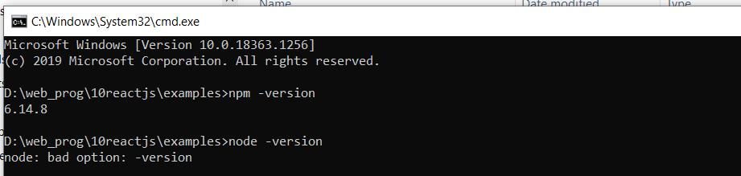
Npm –version node –version will display version installed
npm view react version

Slide 8
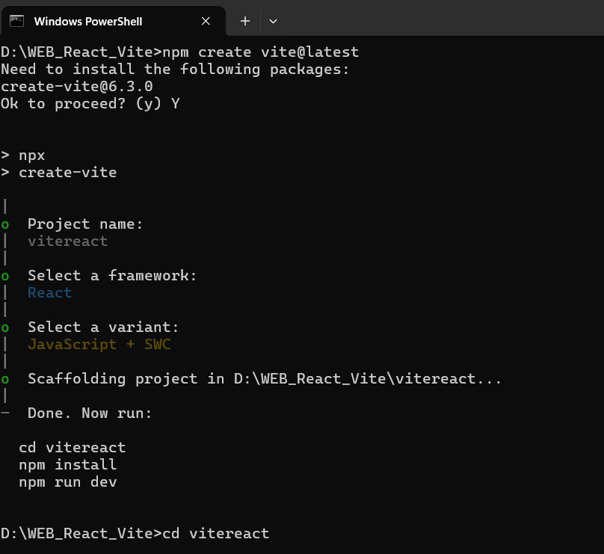
npm create vite@latest
npm install
npm run dev
SWC stands for Speedy Web Compiler.
It is a JavaScript and TypeScript compiler written in Rust, designed to be faster than traditional JavaScript build tools like Babel.
SWC is used for transpilation, taking modern JavaScript/TypeScript code and converting it into code that can be run in older browsers.
It can also be used for bundling and minification.
Due to its speed and efficiency, SWC is often integrated into other tools and frameworks like Next.js, Parcel, and Deno to improve build times

Slide 9
Create 1st app C Users\Your Name>npx create-react-app myfirstreac Installing react, react-dom, and react-scripts with cra-template...
The npx stands for Node Package Execute and it comes with the npm, when you installed npm above 5.2.0 version then automatically npx will installed. It is an npm package runner that can execute any package that you want from the npm registry without even installing that package. The npx is useful during a single time use package. If you have installed npm below 5.2.0 then npx is not installed in your system.
Got to project folder:
cd myfirstreact;
C:\Users\Your Name\myfirstreact>npm start
v6>npm install -g create-react-app
If computer name has space then
npm config set cache "C:\Users\Shiram~1\AppData\Roaming\npm-cache" --global

Slide 10
React uses JSX for templating instead of regular JavaScript. It is not necessary to use it, however, following are some pros that come with it.
It is faster because it performs optimization while compiling code to JavaScript.
It is also type-safe and most of the errors can be caught during compilation.
It makes it easier and faster to write templates, if you are familiar with HTML.

Slide 11
JSX looks like a regular HTML in most cases
Notes: ➔
import React from 'react';
const Myelement = React.createElement('h1',{}, 'I do not use JSX!’);
App.jsx ➔demo1
function App() {
return (
<div >
<h1> Hello world!</h1>
</div>
);
}
export default App;
Tag, css, data
Without JSX in App.jsx file
JSX

Slide 12
import React from 'react';
import { createRoot } from 'react-dom/client'
import './index.css';
import App from './App';
import reportWebVitals from './reportWebVitals';
const root = createRoot(document.getElementById('root'));
root.render(
<React.StrictMode>
<App />
</React.StrictMode>
);
// If you want to start measuring performance in your app, pass a function
// to log results (for example: reportWebVitals(console.log))
// or send to an analytics endpoint. Learn more: https://bit.ly/CRA-vitals
reportWebVitals();

Slide 13
What is ReactDOM createRoot ()?
createRoot(container[, options]); Create a React root for the supplied container and return the root. The root can be used to render a React element into the DOM with render :
const root = createRoot(document.getElementById('root'));
root.render(
<React.StrictMode>
<App />
</React.StrictMode>
);

Slide 14
import React from 'react';
import ReactDOM from 'react-dom/client’;
import { createRoot } from 'react-dom/client'
import './index.css';
import App from './App';
import reportWebVitals from './reportWebVitals’;
const Myelement = React.createElement;
const root = createRoot(document.getElementById('root'));
root.render(
Myelement('h1',{},'I do not use JSX!')
);
// If you want to start measuring performance in your app, pass a function
// to log results (for example: reportWebVitals(console.log))
// or send to an analytics endpoint. Learn more: https://bit.ly/CRA-vitals
reportWebVitals();
demo2

Slide 15
Render
Render a React element into the DOM in the supplied container and return a reference to the component (or returns null for stateless components).
If the React element was previously rendered into container , this will perform an update on it and only mutate the DOM as necessary to reflect the latest React element.

Slide 16
Put this code in index.js file
const Myelement = React.createElement;
const container=React.createElement;
const root = createRoot(document.getElementById('root'));
root.render(
container('div',{},Myelement('h1',{}, 'I do not use JSX!'))
);
//remove <app/>
<div>
<h1></h1>
</div>
The first statement imports the React library itself. Because React turns the JSX we write into React.createElement(), all React components must import the React module. If you skip this step, your application will produce an error.

Slide 17
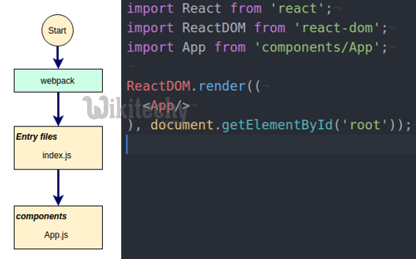
Index.js
import React from 'react';
import ReactDOM from 'react-dom';
import './index.css';
import App from './App';
import reportWebVitals from './reportWebVitals';
ReactDOM.render(
<React.StrictMode>
<App />
</React.StrictMode>,
document.getElementById('root')
);
// If you want to start measuring performance in your app, pass a function
// to log results (for example: reportWebVitals(console.log))
// or send to an analytics endpoint. Learn more: https://bit.ly/CRA-vitals
reportWebVitals();

Slide 18
Certain rules to follow
Nested Elements
If we want to return more elements, we need to wrap it with one container element. Notice how we are using div as a wrapper for h1, h2 and p elements.
function getdata()
{ return (
<div>
<h1>Header</h1>
<h2>Content</h2>
<p>This is the content!!!</p>
</div>
);}
Attributes
We can use our own custom attributes in addition to regular HTML properties and attributes. When we want to add custom attribute, we need to use data- prefix. In the following example, we added data-myattribute as an attribute of p element.
<p data-myattribute = "somevalue">This is the content!!!</p>
JavaScript Expressions
JavaScript expressions can be used inside of JSX. We just need to wrap it with curly brackets {}. The following example will render 2.
<h1>{1+1}</h1>

Slide 19
Certain rules to follow
We cannot use if else statements inside JSX, instead we can use conditional (ternary) expressions. In the following example, variable i equals to 1 so the browser will render true, If we change it to some other value, it will render false.
<h1>{i == 1 ? 'True!' : 'False'}</h1>
Styling
React recommends using inline styles. When we want to set inline styles, we need to use camelCase syntax. React will also automatically append px after the number value on specific elements. The following example shows how to add myStyle inline to h1 element.
function App() {
var myStyle = {
fontSize: 100,
color: '#FF0000'
}
return (
<div>
<h1 style = {myStyle}>Header</h1>
</div>
);
}
export default App;
Comments
When writing comments, we need to put curly brackets {} when we want to write comment within children section of a tag. It is a good practice to always use {} when writing comments, since we want to be consistent when writing the app.
{//End of the line Comment...}
{/*Multi line comment...*/}
Naming Convention
HTML tags always use lowercase tag names, while React components start with Uppercase.
Note − You should use className and htmlFor as XML attribute names instead of class and for.
This is explained on React official page as −
Since JSX is JavaScript, identifiers such as class and for are discouraged as XML attribute names. Instead, React DOM components expect DOM property names such as className and htmlFor, respectively.

Slide 20
function App() {
var myStyle = {
fontSize: 100,
color: '#FF0000'
}
let i=1;
return (
<div>
<h1 style={myStyle}>Header</h1>
<span className='myclass'>{5 + 8}</span>
<h1 style={{color:'red'}}>{i == 1 ? 'True!' : 'False'}</h1>
</div>
);
}
export default App;

Slide 21
Elements are the smallest building blocks of React apps. An element specifies what should be there in our UI. An Element is a plain object describing what we want to appear in terms of the DOM nodes.
Creating a React Element is Cheap compared to DOM elements. An Element can be Created by using JSX or React without JSX. Lets create our first React Element using JSX. Open index.js file from src folder.
const element = <h1>Hello, world</h1>;
We have created an Object of type h1 and assigned it to a variable called as element. This element should be rendered into the Browser DOM, and for that we need a container. Open Index.html and there is a div with id as root and we will use that div as our container.
The above created Element can be rendered into it By writing
ReactDOM.render(element, document.getElementById('root’));
Lets say we want to assign some styles to this element. Create a css class with classname as testclass in index.css. Apply this class to the element using className attribute.
const element=<h1 className="testClass">Hi...</h1>

Slide 22
An Element contains type and properties, here h1 is the type and this element contains className as property. An Element can be as simple as the one we have created or an element can contain elements inside it.
I am creating an Element which contains div and div has a h1 tag and h2 tag and we render this element to the div container. const element = (
<div>
<h1>Welcome to React Programming World</h1>
<h2>Understanding React Rendering…</h2>
</div>
);
const root = ReactDOM.createRoot(document.getElementById('root'));
root.render(element);
Lets save these changes and observe the response in the browser.
The above code we have written using JSX would be compiled into Plain Javascript using Babel. JSX is not a requirement for using React. Using React without JSX is especially convenient when you don’t want to set up compilation in our build environment.

Slide 23
The above code we have written using JSX would be compiled into Plain Javascript using Babel. JSX is not a requirement for using React. Using React without JSX is especially convenient when you don’t want to set up compilation in our build environment.
A React Element can also be created by using
const element = React.createElement("h1",null,'Hello World');
CreateElement method takes few parameters. First one is the type of Element we want to create like h1 or h2 or div. Second parameter specifies the Properties we want to apply to this element. Third one represents the Child Element or Elements that has be placed inside the Parent one. The above line of code tells React that we want a h1 element without properties or attributes applied and Hello World being the Child in it.
If we want to apply the css class we have created to this element then, lets add a Property called className
const element = React.createElement("div",{className:"testClass"},'Hello World');
Lets save this change and see the output in the browser.
Now lets say, we want to create one h1 tag and one h2 tag inside the div element. To achieve this, we have to pass two elements as child elements to this div. So lets go ahead and make changes.
const element=React.createElement("div",{className:"testClass"},
React.createElement("h1",null,'Welcome to Dac'),
React.createElement('h2',null,'I am from h2 Tag'));
Lets save this change and see the output in the browser.
<div>
<h1> Welcome to DAC</h1>
<h2>I am from h2 tag</h2>
<div>

Slide 24
const element = React.createElement("div", { className: "testClass" },
React.createElement("h1", null, 'Welcome to Dac'),
React.createElement('h2', null, 'I am from h2 Tag'));
const root = ReactDOM.createRoot(document.getElementById('root'));
root.render(
element
);
RCE short cut key to create component class rconst for constructor

Slide 25
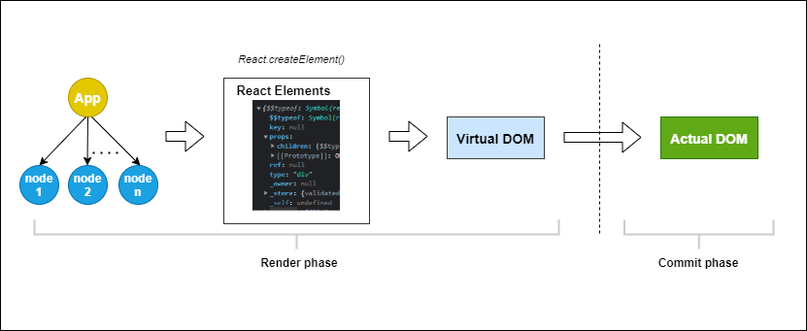
Below is a visual description of the rendering process for initial render.

Slide 26
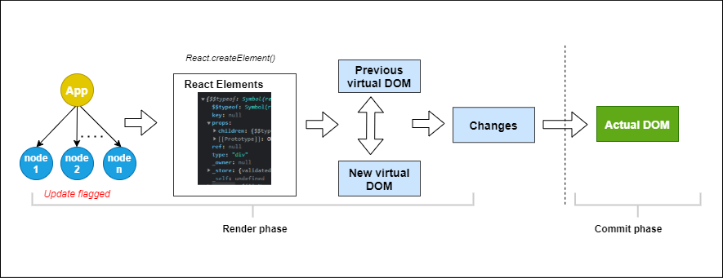
Below is a visual description of the rendering process when an application re-renders.

Slide 27
The Render Phase
Before React components can be displayed on the screen, they must first be rendered by React. The render phase is the initial phase of the rendering process. In this phase, the JSX code is converted to a JavaScript representation of what the HTML structure should look like.
On the initial render, it starts from the root component and works its way down, building out a React element tree of what the actual DOM should look like.
Re-rendering follows a similar approach but with a key difference: it creates a new JavaScript representation of the DOM, identifying all the components marked as needing an update. After this, it uses a process known as diffing to identify the changes between the old and new tree of React elements (aka the virtual DOM)

Slide 28
The Virtual DOM
Invoking a component causes React to instantiate it and return a plain JavaScript object describing a component or an HTML tag called a React element. This object and its children make up the virtual DOM.
React needs to ensure that the application’s UI is always in sync with the React state. To achieve this, whenever a component’s state changes, it has to re-render all potentially affected components (the component that owns the state and its descendants).
Programmatically Navigate with React Router
Programmatic navigation refers to when a user is redirected as a result of an action that occurs on a route, like a login or signup action. In this article, we look at a myriad of approaches to navigating programmatically with React Router.
Writing to the actual DOM is very expensive and can lead to performance shortcomings, but generating the plain JavaScript objects (virtual DOM) is really easy. React uses the virtual DOM to reduce the excess cost incurred from repainting the entire page whenever a state change occurs that affects the UI.
The virtual DOM is used to figure out the changes without involving the actual DOM and then ensures that the actual DOM updates only the parts of the UI that have changed.

